Slide 1

Student Survey Analysis: Career Services
-Key Insights &Recommendations
By
Unnati Gaglani
Northeastern University

Slide 2

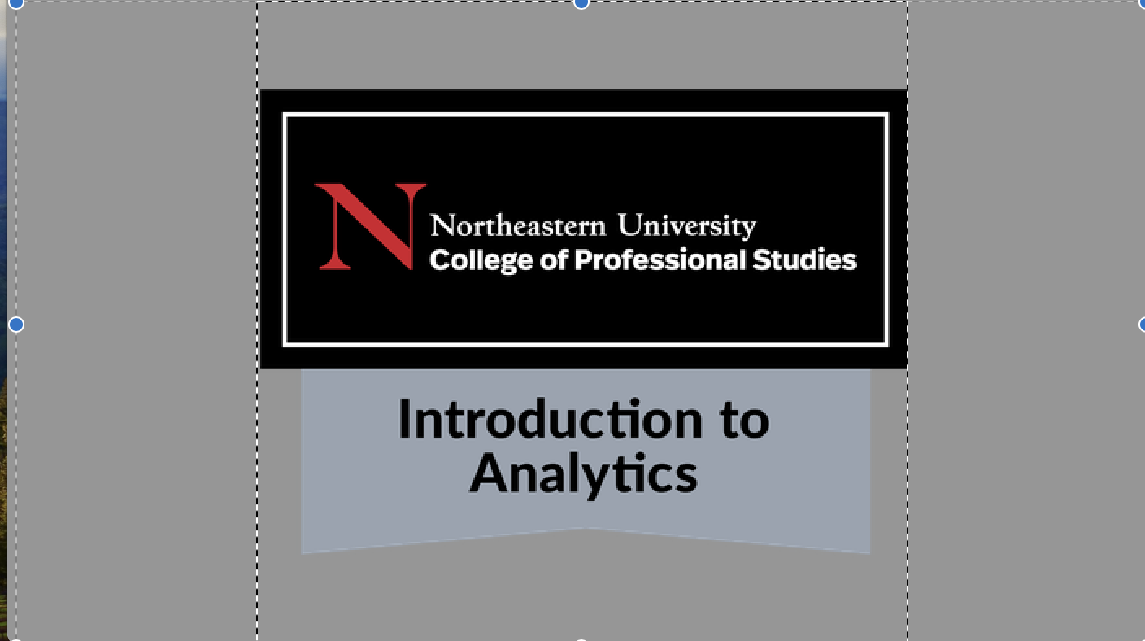
Unnati Gaglani
CPS
Ms. in Project Management Concentration : Data Analytics

Slide 3

The goal of this presentation is to analyze the student satisfaction survey data, identify key findings, and provide actionable recommendations to support the career needs of students at Northeastern University.
Objective

Slide 4
Data Overview
4
Data Structure: The dataset includes responses from 229 students regarding their interactions with career services, demographic information, and feedback on various career support themes.
Key Columns:
College and Program Information: Students' academic affiliations.
Attendance Duration: How long students have been part of their programs.
Career Services Used: Types of career services students utilized.
Career Development Awareness: How students heard about career services.
Feedback and Workshop Topics: Suggestions and feedback from students.
Demographics: Gender, age group, and student status (e.g., international or domestic).

Slide 5
Methodology
5
Data Cleaning: Handling missing values, normalizing responses, Standardizing, Renaming Column
Analysis Technique :
Exploratory Data Analysis
Segmentation & Filtering
Comparative Analysis
Sentimental Analysis
Approach : Focusing on service utilization, awareness channels, demographic breakdowns, and feedback analysis to derive actionable insights.
https://app.powerbi.com/reportEmbed?reportId=fd4f317a-4a8f-44a9-a4d4-baff2806d174&autoAuth=true&ctid=a8eec281-aaa3-4dae-ac9b-9a398b9215e7

Slide 6

Key Insights
1. Service Utilization
Email and Career Digest: Utilized by 60 students.
Workshops & Networking Events: Utilized by 50 students.
Key Insight: "Email and Career Digest" is the most frequently used service. 2. Awareness Channels
Career Digest: 30 students
Career Advisor: 25 students
Social Media (LinkedIn): 20 students
Key Insight: Career Digest and Career Advisors are primary channels for Students

Slide 7
Key Insights (Contd...)
3. Demographic Insights
Gender: Female (58%), Male (28%), Choose not to disclose (5%).
Student Status: International Students (80%), Domestic Students (13%).
Age Group: 25-29 (55%), 24 and under (20%).
4. Feedback Themes
Common Themes: Requests for more recruiter events, desire for specialized resources.
Key Insight: Majority of respondents are female, international students aged 25-29.

Slide 8
Recommendation
8
1. Expand and Enhance Popular Services : Increase the availability and diversity of high-demand services like "Email and Career Digest" and "Workshops & Networking Events."
Next Steps:
Workshops: Introduce new topics based on student feedback and increase the frequency of existing ones.
Career Digest: Ensure it remains a key resource by continuously updating it with relevant information and opportunities
2. Optimize Communication Strategies : Prioritize the most effective communication channels—Career Digest, Career Advisors, and LinkedIn—to engage students.
Next Steps:
Career Digest: Regularly refresh content to keep students informed and engaged.
Career Advisors: Enhance personalized outreach, ensuring students are aware of available resources.

Slide 9
Recommendation (contd...)
9
3. Develop Tailored Support for International Students : Create specialized career support initiatives for international students, who represent a significant portion of the respondents.
Next Steps:
Workshops: Focus on visa-related employment, cultural adaptation, and global job market navigation.
Advising: Provide one-on-one sessions that address the specific needs and concerns of international students.

Slide 10
Conclusion
10
Conclusion
Summary: The analysis highlights the importance of targeted service enhancement, strategic communication, and tailored support for key student demographics. By implementing these recommendations, the campus can better meet the career development needs of its diverse student body.
Final Thoughts: Moving forward, continuous evaluation and adaptation will be crucial to ensuring the effectiveness of these initiatives and maintaining student satisfaction.

Slide 11
Thank You
Unnati Gaglani
Gaglani.u@northeastern.edu

